Slide 1
Corporate Volunteering
KPMG
16 June 2022

Slide 2
Agenda Submitting Tax Returns Submitting KANAs Salesforce: Tasks and Closure Technical queries Accreditation and Audit

Slide 3
Submitting Tax Returns
Submission of Returns via Taxfiler
Demonstration ‘Mr Client Test’ – 2021 TR
Instructions are:
Click on ‘Review and File’ tab
Click on ‘Client has approved this Tax Return’
‘Tick to confirm client has approved this Tax Return for filing?’ and click ‘OK’.
Click on ‘Submit this Tax Return to HMRC’
Tick the box for ‘Confirm you wish to submit to HMRC’
REPLACE the email address with help@taxaid.org.uk
Click on the Send button
Confirmation message should show in Taxfiler within a minute

Slide 4
Submitting KANAs
Demonstration ‘Mr Test Client’
In Salesforce on the Home Tab there are ‘Useful Links’ in the top right hand corner.
One of the links is for the KANA email.

Slide 5
Submitting KANAs (2)
Help sheet on completing KANAs will be uploaded to the KPMG folder on the TaxAid website.
A receipt for the KANA transmission and the eventual reply will get sent to help@taxaid.org.uk
The receipt will be uploaded to the file section of Salesforce.
The KANA reply will be uploaded and a task will be sent to you notifying you of this.
HMRC aim to send a reply to the KANA within fifteen working days.

Slide 6
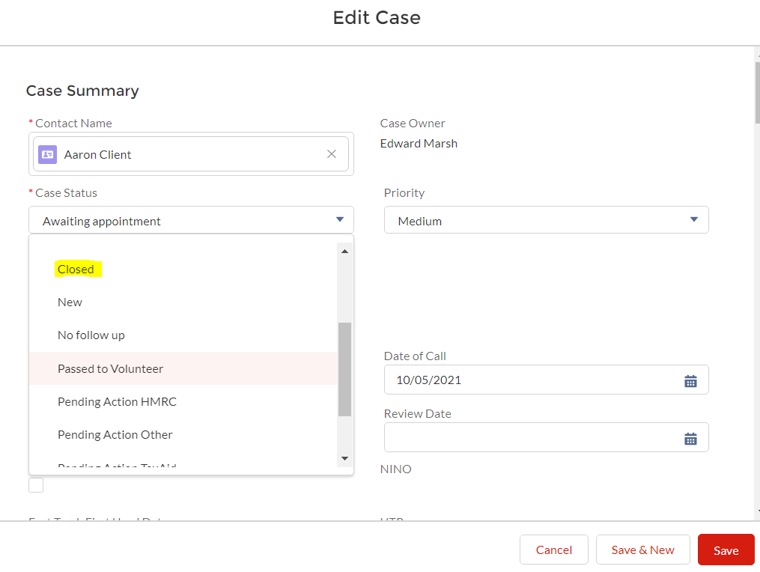
Salesforce – closing cases
Process for closing a file on Salesforce
Once everything is up to date for the client – all outstanding Tax Returns have been sent and all claims have been made – you can close the Salesforce record. This is an opportunity for you do a final file review to ensure that everything has been done.
Make sure all fields have been completed.
Check that all Tasks have been closed.
Edit the case and mark the case status as ‘Closed’.
Change Case Owner to Harry Fulton.

Slide 7
Technical queries
From time to time you may get technical queries from Team member volunteers. If you do not know the answer then ask TaxAid
Accreditation gives Team Leaders the power to make submissions to HMRC and move a case forwards.
If volunteers in your team have any queries you can (and should!) still come to TaxAid for anything you are not sure about. Accreditation does not mean the end of TaxAid support – the support is there when you need it.

Slide 8
Auditing of cases
Accreditation is a status which is subject to audit
As explained I will no longer be reviewing each and every case.
Instead an audit will be performed – 3 in every 10 completed cases.
If any audited case turns out to be ‘Amber’ then the frequency of audit will increase – 5 in every 10 cases.
If any audited case turns out to be ‘Red’ then we go back to every case being reviewed and the accreditation process re-starts.
In the event accreditation is lost Tax Return and KANA submission reverts to TaxAid and any tasks re submission should go to me.

Slide 9
Questions & Answers
……………………………………………………………

Slide 10
Providing tax help to all who need it.
Address:
30 Monck Street London SW1P 2AP.
Telephone: 020 7803 4950
TaxAid is a charity registered in England & Wales (No. 1062852).

